Slide 1
COMP1860 Building our Digital World: Computer Systems & Architecture
S1.W1.L0: Module Details
Prof Andy Bulpitt, Dr Arash Bozorgchenani,
Dr James Dyer & Dr Massimiliano Fasi

Slide 2
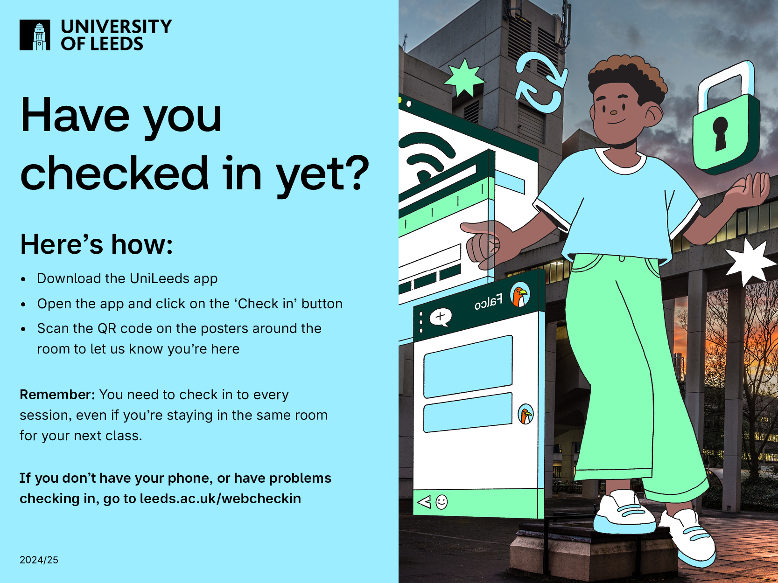

Slide 3
Staff
Module Leader: Prof Leandro Indrusiak
Additional Lecturers: Dr Arash Bozorgchenani, Dr James Dyer, Dr Massimiliano Fasi
Teaching Assistants and Fellows

Slide 4
Lectures
Two per week (except for week 5)
Lecturer
  Dr James Dyer, (Autumn term, weeks 1-4)
  Prof. Leandro Indrusiak (Autumn term, weeks 6-11),
  Dr Massimiliano Fasi (Spring term, weeks 1-5)
  Dr Arash Bozorgchenani (Spring term, weeks 6-10)
Lecture slides posted in Minerva

Slide 5
Week 5
There will be no lectures in week 5
Instead, you will have two 2-hour sessions in the computer labs
These will be a mix of lectures and lab exercises

Slide 6
Text Books
Noam Nisan and Shimon Schocken, The Elements of Computing Systems: Building a Modern Computer from First Principles
  MIT Press, 2nd Edition, 2021
  Available online
  NAND2Tetris website
Suzanne J. Matthews, Tia Newhall and Kevin C. Webb, Dive into Systems
  No Starch Press, August 2022 (ISBN-13: 9781718501362).
  Available online

Slide 7
Text Books
William Stallings, Computer Organisation and Architecture: Designing for Performance,
  Pearson Education, 11th edition, 2021
  Available online

Slide 8
Weekly Tutorials & Lab Sessions
In weeks 1-4, you will have a 1-hour tutorial session
  Labs will replace tutorials after week 4
In weeks 5-10, you will have a 2-hour lab session
In both cases
  See your timetable for dates;
  Ran by competent teaching assistants (some are PhD students);
  Time to work on portfolio questions with support from teaching assistants
  No new content will be introduced; TAs are there to answer questions (focusing on worksheets);

Slide 9
Worksheets
There will be 9 worksheets in Semester 1 and 8 worksheets in Semester 2
Most questions are formative (unassessed)
  This work is not for credit (i.e., the work does not contribute to your grade) but to help you in your learning journey.
  Solutions will be posted in Minerva the following week
Questions marked as Portfolio Tasks or in red boxes are summative (assessed)
  Gradescope quiz or coding exercise
  The work is for credit and contributes to your portfolio
  You need to complete all questions in red boxes
  Submission date/time is 1400 on the Friday of the following week
    You may submit as many times as required to achieve a passing score
  Feedback to submissions will be provided in Gradescope

Slide 10
Assessment
Portfolio
  Online quiz or programming assignment
  Submitted via Minerva or Gradescope
  See worksheets for details
  9 portfolio tasks in semester 1
  8 portfolio tasks in semester 2
Synoptic Project (part of portfolio)
  In combination with COMP1850
  Produce an extended piece of work
  Date: January 2027
Examination
  Questions from material covered over the year
  All material from lectures is potentially examinable
  Date: May/June 2026

Slide 11
Portfolio Rules
Worksheets are released on Monday of each week
  No worksheet in week 6 or week 11 of semester 1
Portfolio task deadline is 2pm on the Friday of the following week
Two submission points for each portfolio task
  ON-TIME: closed at 2pm on the Friday of the following week
  LATE/RESUBMISSIONS: Opened a at 2pm on the Friday of the following week, closed at 2pm on January 22nd 2027.
  Only submit to the LATE point if the ON-TIME point has closed and you have not yet passed for that task

Slide 12
Portfolio Rules
If you do not complete and pass all semester 1 portfolio tasks by 2pm on January 22nd 2027, you will fail the module.
If you have more than 3 late submissions in each semester, you will fail the module.
  Need 6 on-time submissions that pass in semester 1
  Need 5 on-time submissions that pass in semester 2
If you fail the module, you will only receive a maximum module mark of 40, providing you pass all portfolio tasks (either late or at re-sit)

Slide 13
Number of attempts
For multiple-choice quizzes you have a maximum of 10 attempts per submission point
  10 for the ON-TIME submission point
  10 for the LATE/RESUBMISSIONS submission point
For Gradescope programming assignments you have unlimited attempts per submission point

Slide 14
Minerva Gradebook
Your results will be recorded in the Minerva Gradebook
Your score will be assigned a letter grade
Please note that the decisions made on letter grades only apply after the deadline has passed
  However, please check the gradebook to determine if you have passed the exercise or not

Slide 15
What the Minerva Grade Letters Mean (after the deadline)
ON-TIME
LATE/RESUBMISSIONS
P – you have passed the portfolio exercise
O – you have not passed the portfolio exercise, but you have submitted a serious attempt on-time.
  You will need to resubmit to pass the exercise, but it will not be recorded as a late submission
L – you have not submitted a serious attempt on-time, your submission is considered late.
  You will need to resubmit to pass the exercise, and it will be recorded as a late submission
P – you have passed the portfolio exercise
F – you have failed the portfolio exercise
  You will need to re-sit the portfolio in the summer

Slide 16
Assessment Schedule
Week | Week Commencing | Worksheet | Portfolio Task | Deadline
1 | 28/09/2026 | 1.1 | Worksheet 1.1 Quiz | 09/10/2026 17:00
2 | 05/10/2026 | 1.2 | Worksheet 1.2 Quiz | 16/10/2026 17:00
3 | 12/10/2026 | 1.3 | Worksheet 1.3 Quiz | 23/10/2026 17:00
4 | 19/10/2026 | 1.4 | Worksheet 1.4 Quiz | 30/10/2026 17:00
5 | 26/10/2026 | 1.5 | Worksheet 1.5 Exercise 2 | 06/11/2026 17:00
6 | 02/11/2026 | No worksheet | Reflection | Not applicable
7 | 09/11/2026 | 1.6 | Worksheet 1.6 Exercise 1 | 20/11/2026 17:00
8 | 16/11/2026 | 1.7 | Worksheet 1.7 Exercise 1 | 27/11/2026 17:00
9 | 23/11/2026 | 1.8 | Worksheet 1.8 Exercise 1 | 04/12/2026 17:00
10 | 30/11/2026 | 1.9 | Worksheet 1.9 Exercise 1 | 11/12/2026 17:00
11 | 07/12/2026 | No worksheet | No portfolio task | Not applicable

Slide 17
Grades
Fail 0-39
3rd 40-49
2:2 50-59
2:1 60-69
1st 70+

Slide 18
Lecture Exercises
Throughout the lecture there will be exercises for you to do.
There will be some time in lectures to complete these exercises.
Again, this is formative (not assessed).

Slide 19
How to get help
Read lecture content before the lecture
Attend the lecture ready to get involved
  Please bring pen & paper and a laptop/tablet
Get the worksheet and attempt before the tutorial or lab. Send questions to tutorial leader if something is not clear
Read the textbook reference for more depth on each section

Slide 20
Microsoft Teams
The module Team is the way to get help out of contact time
  You can access it from the Teams tab of Microsoft Teams
Responses within 48 hours during working hours only
Do not send direct messages to module staff. They will not be answered

Slide 21
Summary
Two lectures per week;
Regular coursework & project (portfolio, worth 40%);
End of year exam;
Use tutorial/lab sessions to seek help on coursework.

